Slide 1
Principal Component Analysis
Dr. SINGARA singh Kasana
Associate Professor, CSED
TIET, Patiala

Slide 2
Principal Component Analysis
The Principal Component Analysis is a popular unsupervised learning technique for reducing the dimensionality of data.
It increases interpretability yet, at the same time, it minimizes information loss.
It helps to find the most significant features in a dataset and makes the data easy for plotting in 2D and 3D.
PCA is primarily used for dimensionality reduction in machine learning..

Slide 3
PCA Working Example
Sample Dataset
X | Y
4 | 11
8 | 4
13 | 5
7 | 14
Number of features =2 ; X and Y
Number of samples =4
Mean of X = 8
Mean of Y = 8.5

Slide 4
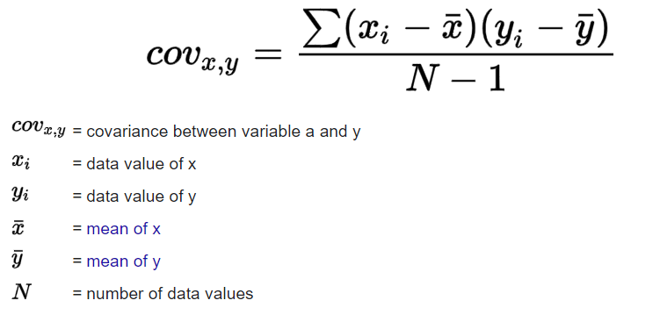
Computation of Covariance Matrix

Slide 5
Computation of Covariance Matrix
Cov (X,X) = [1/ (4-1)]x [ (4-8)² + (8-8)² + (13-8)² + (7-8)² ] = 14
Similarly we can get
Cov (X, Y) = Cov(Y, X)= [1/ (4-1)]x [ (4-8) (11-8.5) + (8-8)(4-8.5) + (13-8)(5-8.5) + (7-8)(14-8.5) ] = -11
Cov(Y, Y ) = [1/ (4-1)]x [ (11-8.5)² + (4-8.5)² + (5-8.5)² + (14-8.5)² ] = 23
Example for Matrix Transformation: https://www.mathsisfun.com/algebra/matrix-transform.html

Slide 6
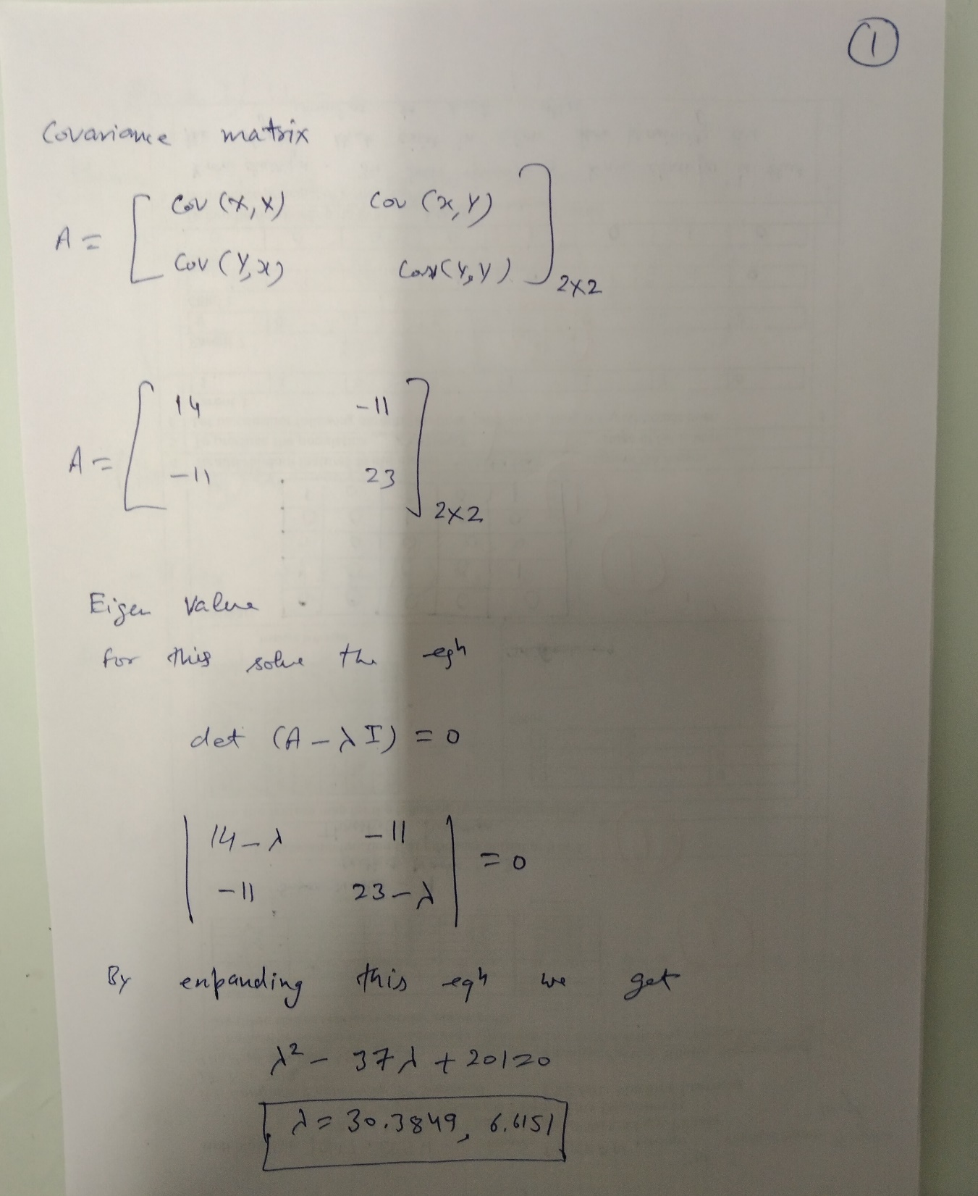

Slide 7
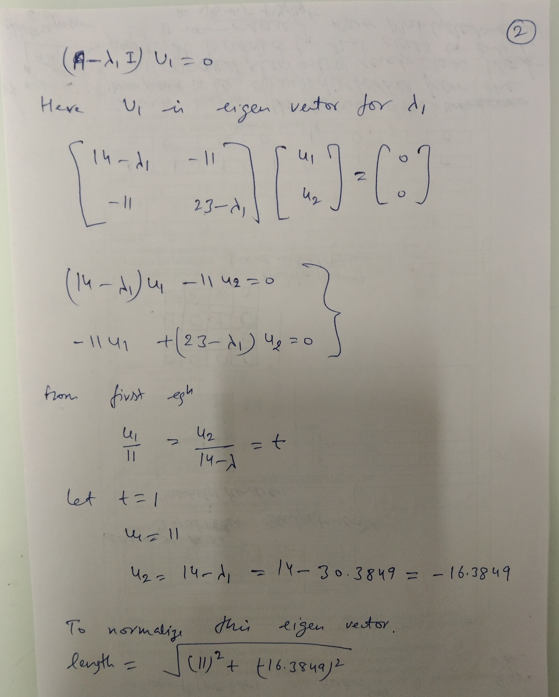

Slide 8
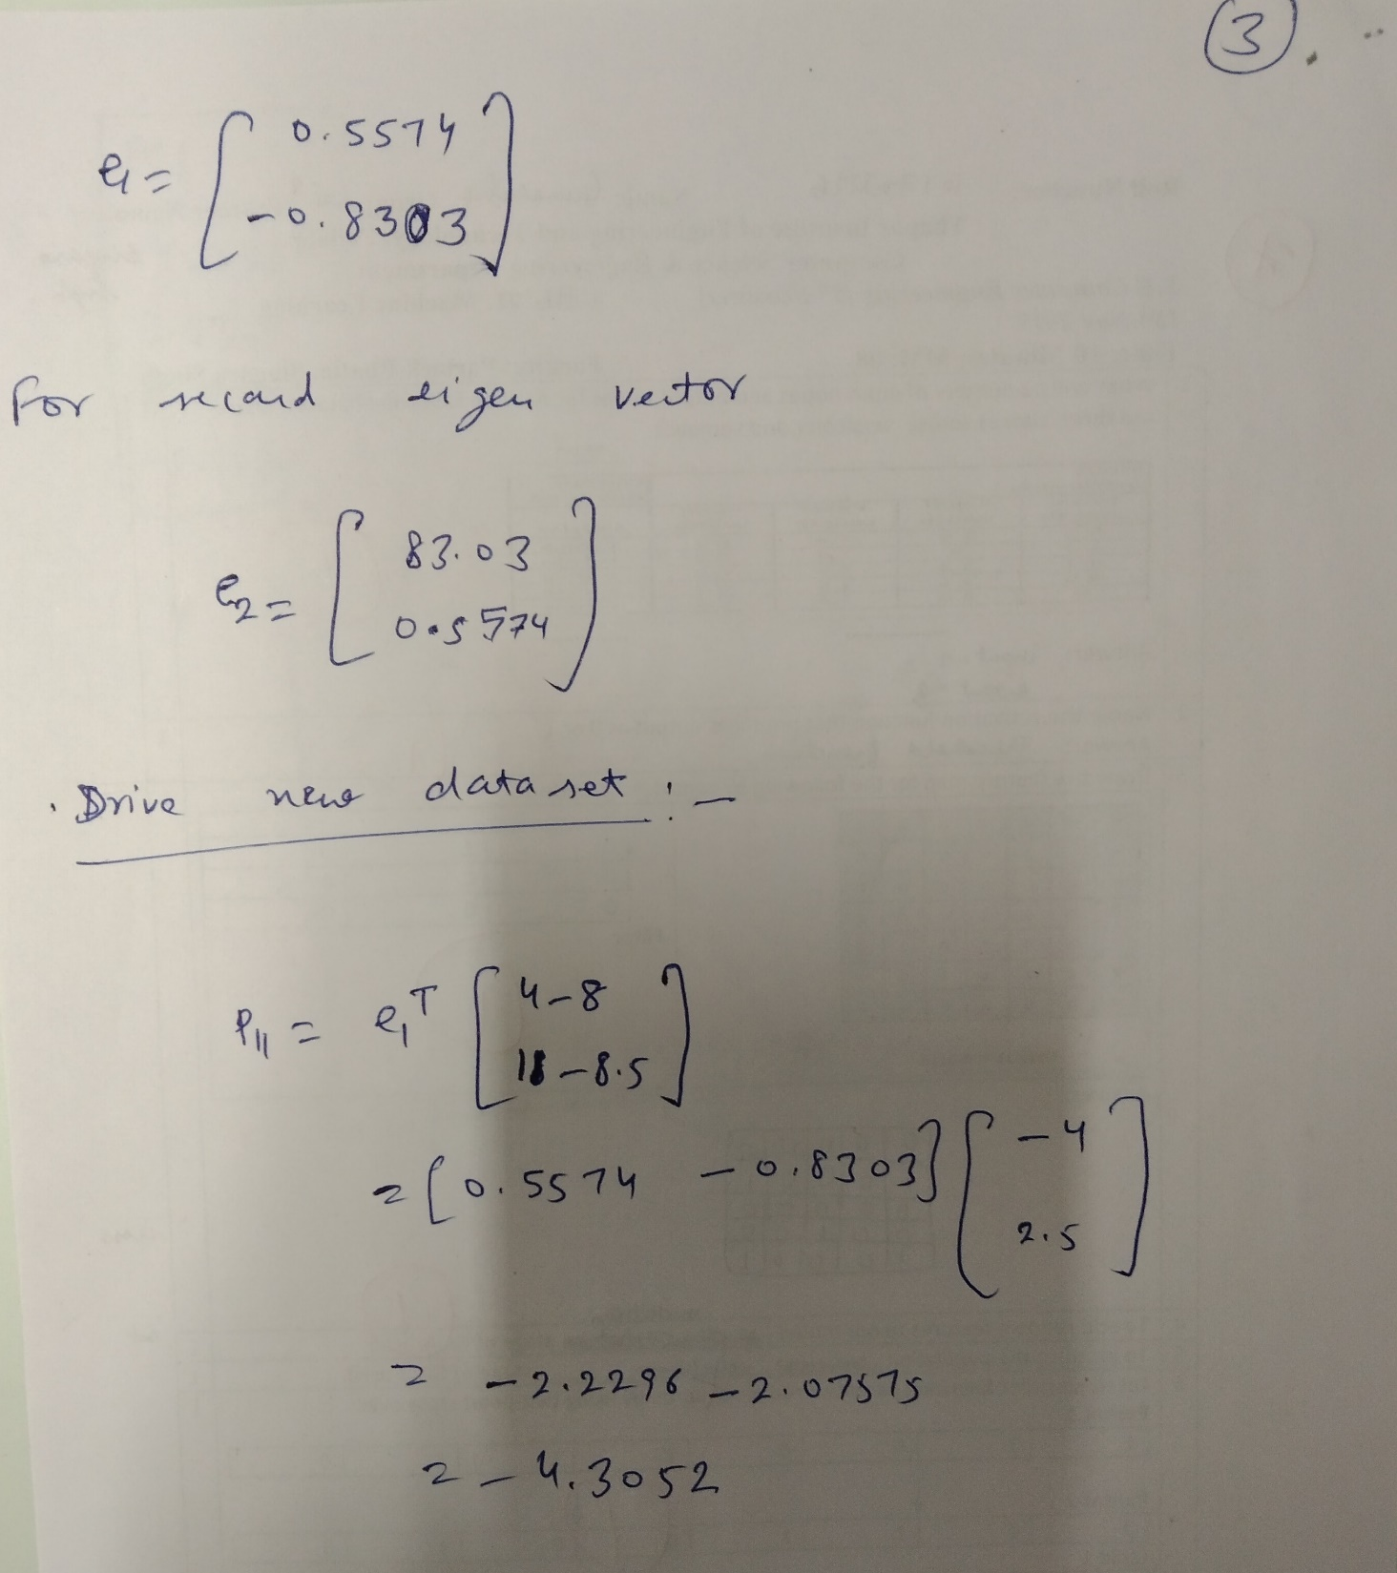

Slide 9
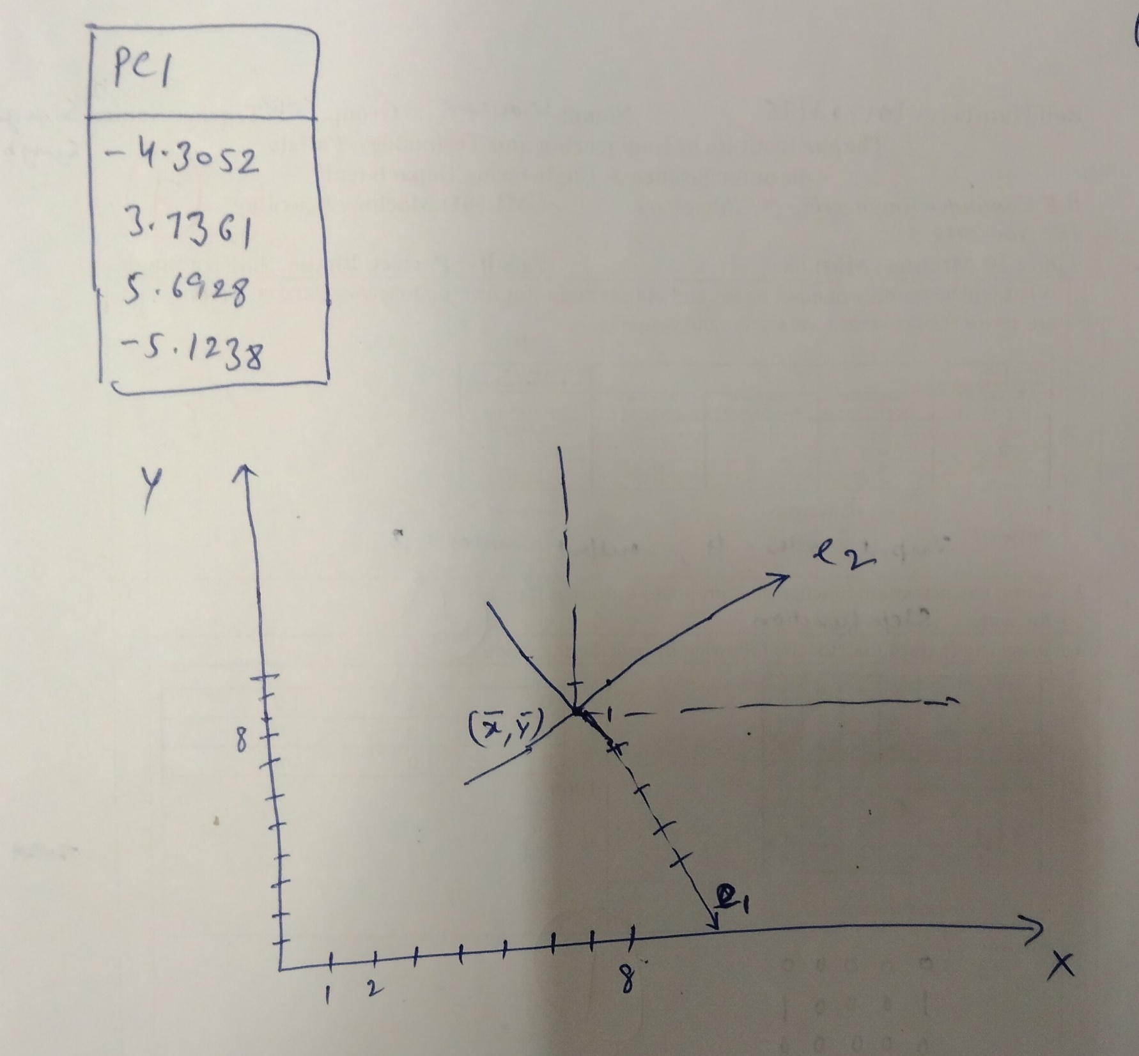

Slide 10
Thanks

